Slide 1
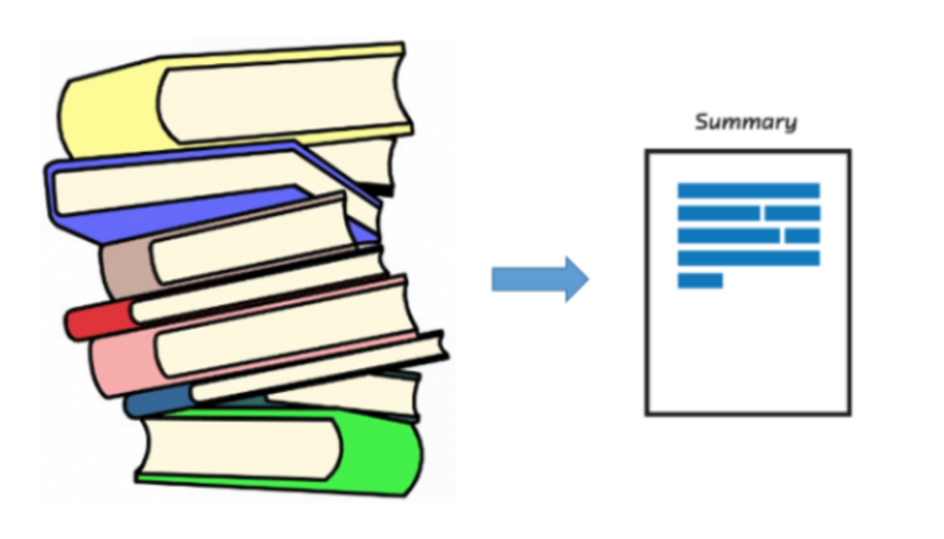
Text Summarization
Team 3
Harshini Gadige - 015351232
Mohini Patil - 015359188

Slide 2
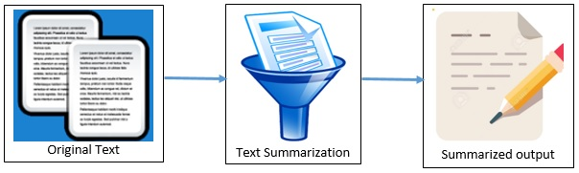
Motivation and Objective
Motivation
There is always redundant and overlapping information present in the document which leads to wastage of time.
Summarizing the documents and extracting important information reduces a large amount of data into a smaller size and saves lot of time.
Manual text summarization is time consuming and laborious task, so there is need of automatic text summarization.
Objective: Natural Language Processing (NLP) - Compare two types of implementations - using a library and factor-based approach

Slide 3
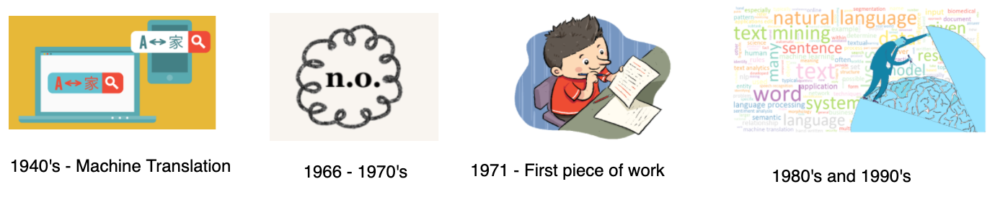
Background
Important application of NLP which existed during 1940’s
1950’s - syntactic theory language and parsing algorithms
1971 - First piece of work Winograd’s SHRDLU thesis at MIT in 1971 (Yorick Wilks)
1980’s and 1990’s NLP started gaining interest as a field of research
Earlier summarization is done using rule-based algorithms and is called “Importance evaluator”
Progression in the text summarization field - calculate the relatedness of a piece of text to other texts in the corpus
Summarization using Neural Networks in NLP
Parallel development - Diversity based approach(extractive summarization) using K-Means clustering extended with Minimum Description Length Principle
More in the side of extractive summarization - Graph based algorithms, encoder/decoder etc.

Slide 4
Literature Review
Author | Year | Method | Description
Chin-Yew Lin et al. | 2004 | ROUGE-N, ROUGE-L, ROUGE-W, and ROUGE-S | automatic evaluation package for text summarization
Dharmendra Hinhu et al. | 2015 | Extractive Text summarization approach | Used Wikipedia Articles as input to the system and identifies the text scoring
Pankaj Gupta et al. | 2016 | SVM, Naive Bayes classifier | Sentiment analysis, analyze the sentiments, emotions present in the text
Akshil Kumar et al. | 2017 | TextRank, LexRank, Latent Semantic Analysis (LSA) | ROUGE-1 is used for evaluation, TextRank provides better results
Tacho Jo | 2017 | K- Nearest Neighbor | Text Summarization viewed as a classification task, KNN and clustering provides better performance
ROUGE: Recall Oriented Understudy for Gisting Evaluation

Slide 5



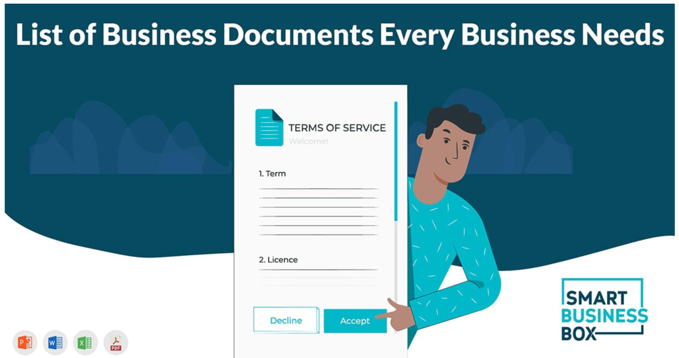

Fields of Applications Our Project : Summarizes the articles

Slide 6
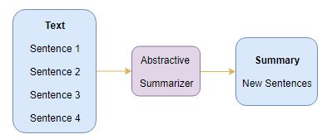
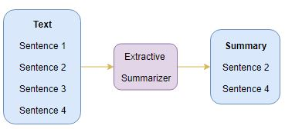
Types of summarization - Based on Output Type
Extractive summarization
It works by selecting the most meaningful sentences in an article and arranging them in a comprehensive manner. This means the summary sentences are extracted from the article without any modifications.
Abstractive summarization
It works by paraphrasing its own version
of the most important sentence in the article.

Slide 7
Types of summarization - Based of Input Type
Single-document summarization
Using single document.
Document can be referred as pdf file, financial report, url, email, etc.
Multi-document summarization
Generating summary by combining multiple documents generated by search engine or from database

Slide 8
Types of summarization - Based on Purpose of Summarization
Generic
The model makes no inference about the meaning of summarized text or any knowledge of domain.
It makes a generic summary of the whole text, documents, photos or video clips.
Domain-Based
The model uses specific domain knowledge about medical or scientific documents.
This increases the accuracy and gives meaningful, concise and easily understandable summary of the whole text.
Query-Based
Input in the form of query and based on that query model makes summary by selecting sentences and phrases that are very much similar to the given query.

Slide 9
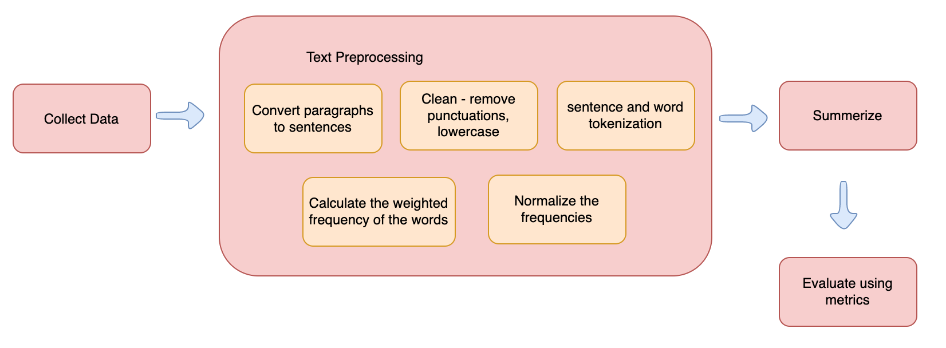
Methodology - CRISP-DM

Slide 10
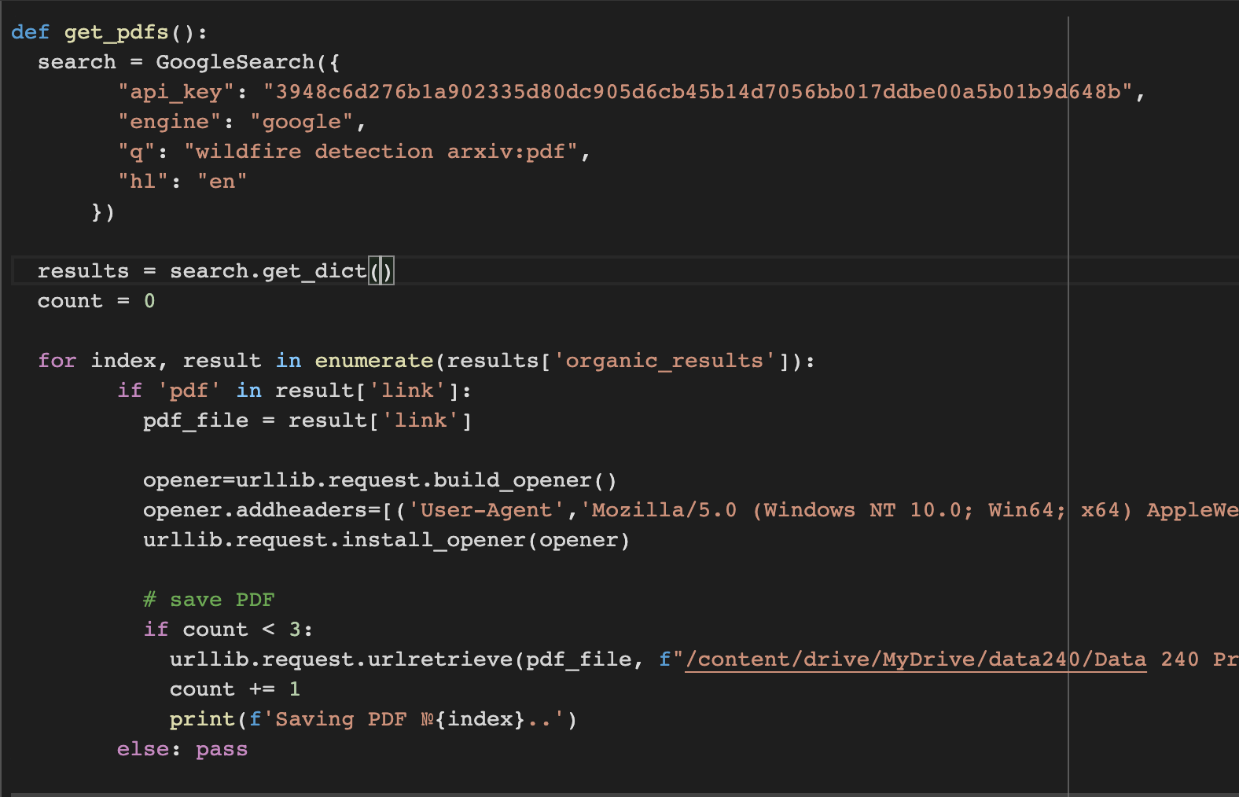
Methodology: Data Collection
Downloading articles from google search engine for text summarization using serpapi python library
Wrote a python script for downloading pdf files based on the query provided
Script will save pdf files in driver folder
Merging the articles
api key
query

Slide 11

Methodology: Data Pre-processing
Cleaning
Remove the stopwords (using spacy lib)
Remove Punctuations (using string lib)
Stemming (using snowball lib)
PreProcessing
Word tokenization
Sentence tokenization
Weighted word frequency
Calculate sentence scores
Normalize the sentence scores

Slide 12
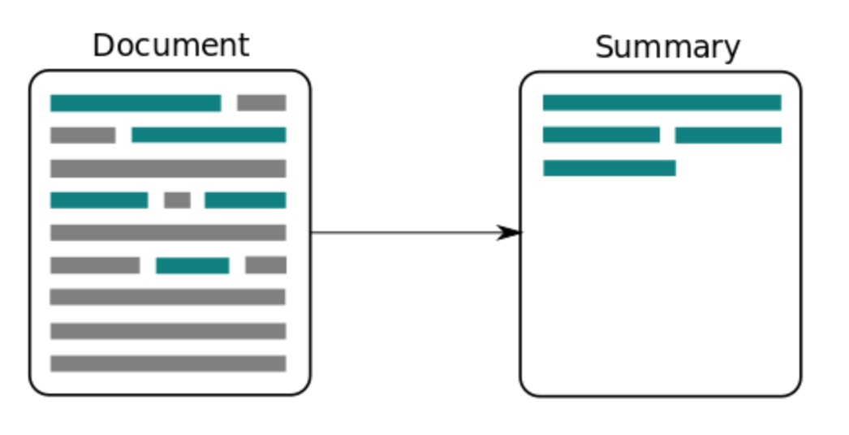
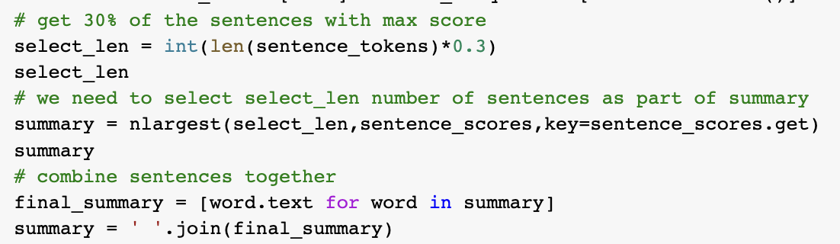
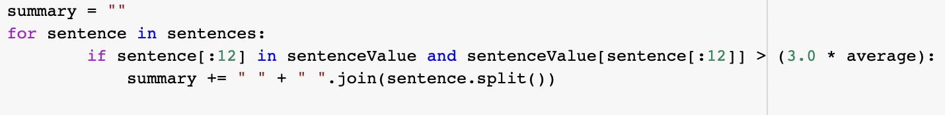
Methodology: Modeling
Using library
heapq from nlargest
30% of the content is taken as part of the summary
Factor-based implementation

Slide 13
Differences in implementation
Heapq | Factor-based
No Stemming done | Stemming is done using snowball lib
Tokenization is done using spacy | Tokenization is done using nltk
Selecting 30% sentences in final summary | Selecting sentences that exceed average value in final summary

Slide 14
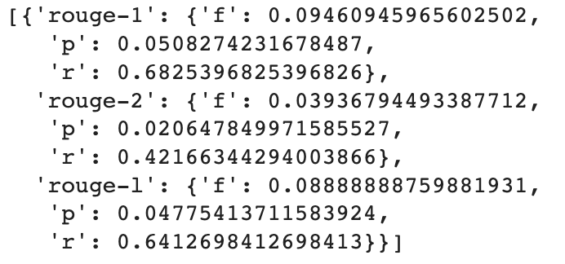
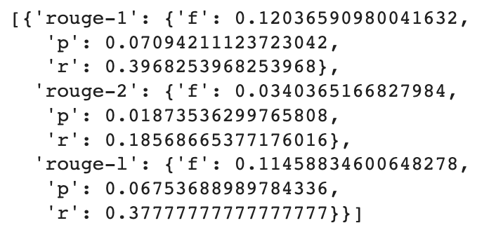
Result - Evaluation Metrics
Compare the summary results from both the methods of implementation with the human generated summary
Rouge - A library to measure f1, precision & recall
Cosine Similarity
Using heapq - 79.4% similar
Factor-based implementation - 77.6% similar
Readability
Using heapq - not so readable
Factor-based implementation - readable
heapq
factor-based

Slide 15
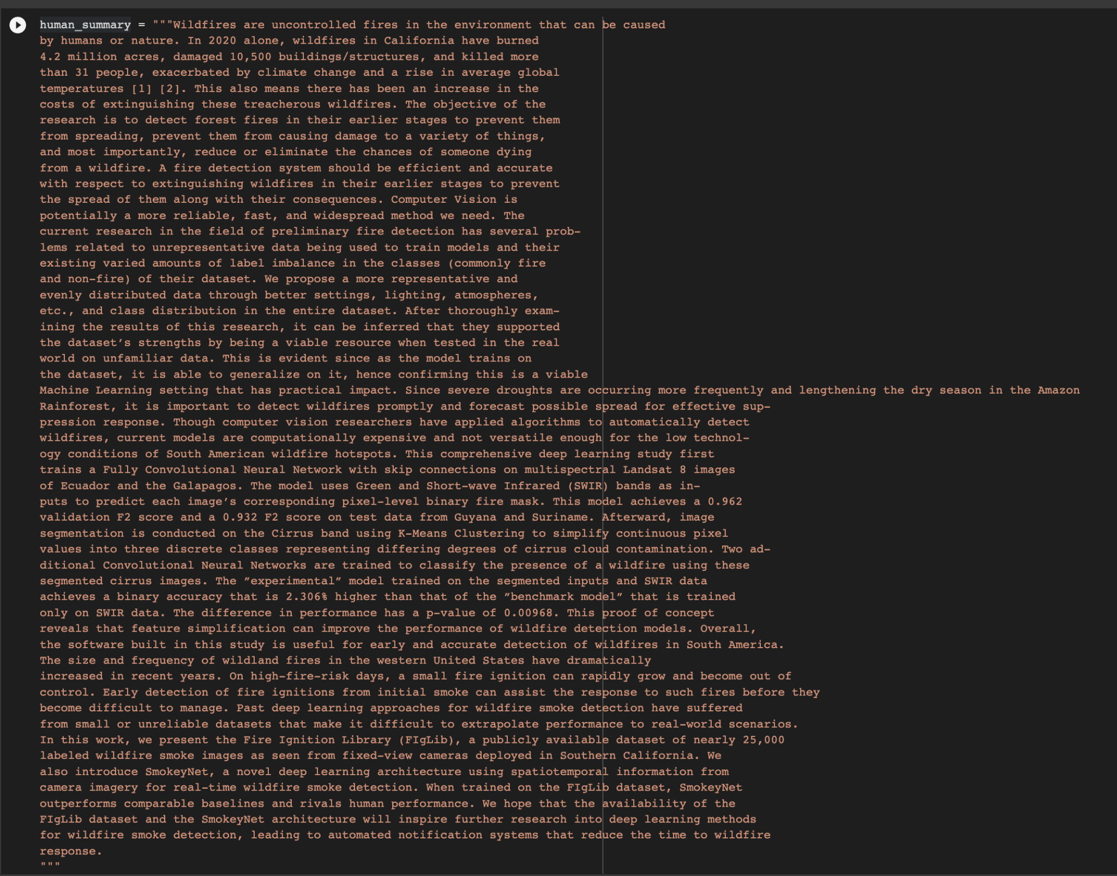
Human Summary
Combined abstracts from all the articles

Slide 16
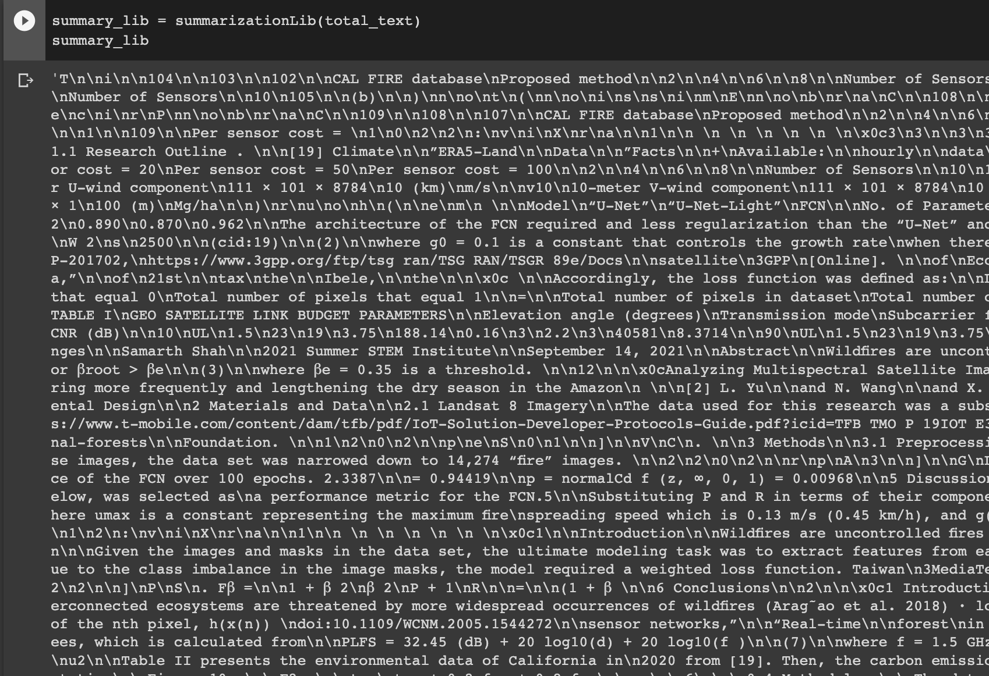
Summarization function using spacy and heapq
Generated Summary

Slide 17
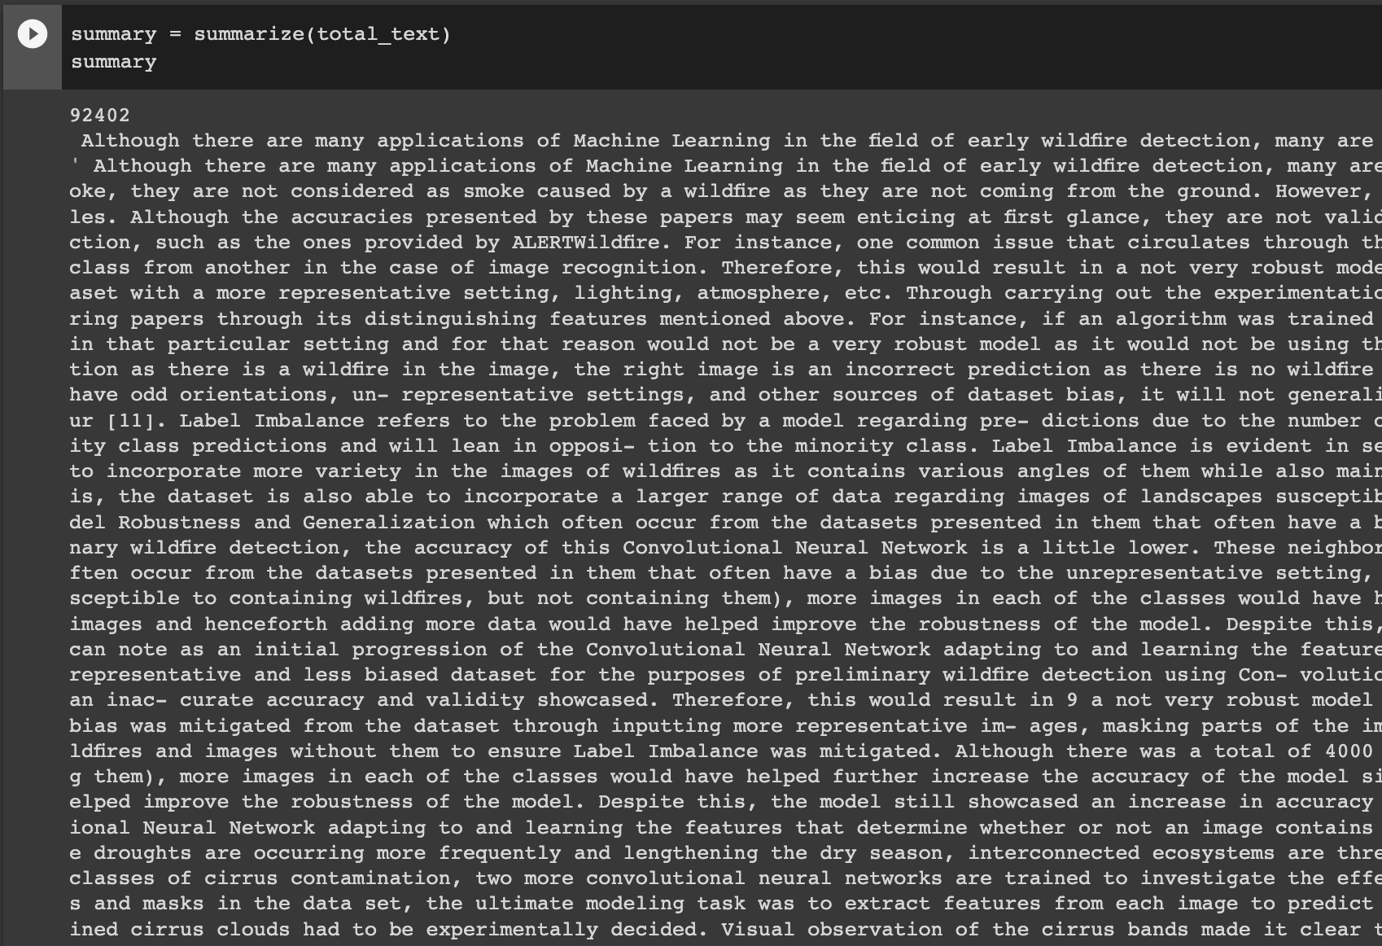
Summarization function from Factor-based
Generated Summary

Slide 18
Discussions and Future Improvements
Limitations
Implemented only with respects to pdf documents
Used only intrinsic measures for evaluation
Applicable to only English language
Future improvements
Need to improve readability by doing more preprocessing (Lemmatization, removing extra spaces, text rephrasing, html tags, digits, spell and grammar check etc.)
Can also implement using Deep Learning models - Sequence-to-Sequence (Seq2Seq)

Slide 19

References
https://www.analyticsvidhya.com/blog/2020/12/tired-of-reading-long-articles-text-summarization-will-make-your-task-easier/
https://www.frase.io/blog/20-applications-of-automatic-summarization-in-the-enterprise/
https://journalijcar.org/sites/default/files/issue-files/4896-A--2018.pdf
https://medium.com/@prasasthy.sanal/brief-history-of-text-summarization-9d1b3787a707
https://ieeexplore-ieee-org.libaccess.sjlibrary.org/document/9183355
https://www.analyticsvidhya.com/blog/2021/06/must-known-techniques-for-text-preprocessing-in-nlp/
https://www.analyticsvidhya.com/blog/2020/12/tired-of-reading-long-articles-text-summarization-will-make-your-task-easier/
https://ilmoirfan.com/rouge-an-evaluation-metric-for-text-summarization/

